Slide 1
Characteristics of the Six Kingdoms of Living Things

Slide 2
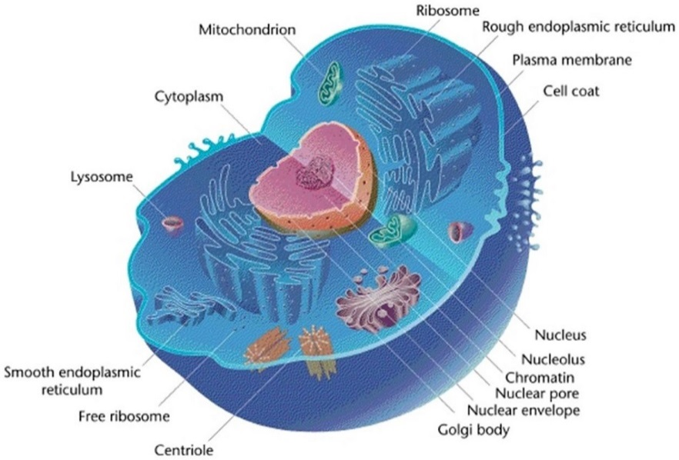
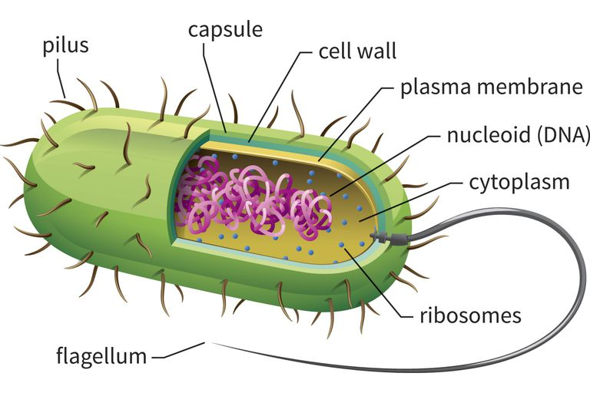
Prokaryotic & Eukaryotic
Prokaryotic: a single-celled organism that does not have a nucleus or membrane-bound organelles
Eukaryotic: an organism made up of cells that has a nucleus

Slide 3
PROKARYOTIC: | EUKARYOTIC:
1. Archaebacteria 2. Eubacteria | 1. Plants 2. Animals 3. Fungus 4. Protist

Slide 4
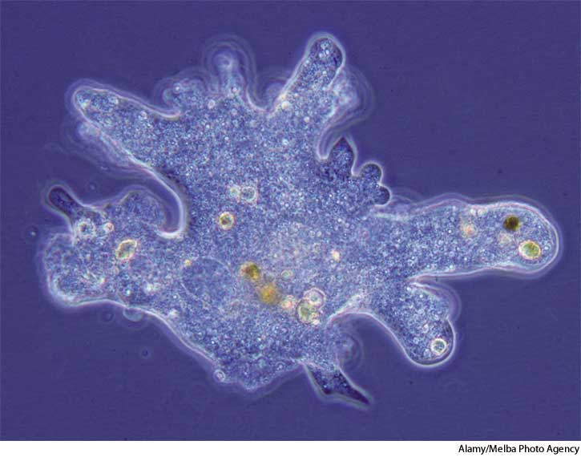
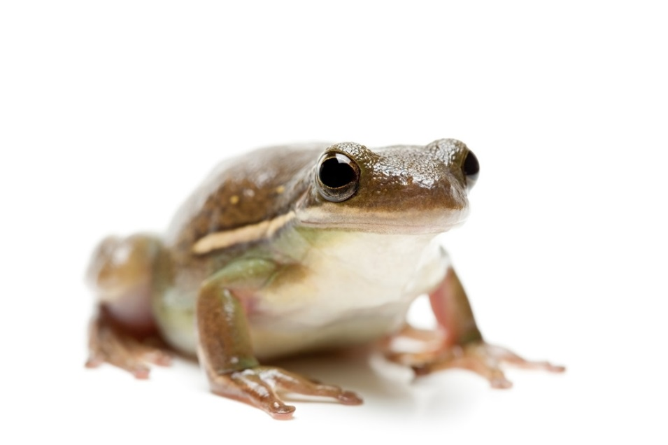
Unicellular & Multicellular
Unicellular: as a single-celled organism
Multicellular: Having or consisting of many cells or more than one cell

Slide 5
UNICELLULAR: | MULTICELLULAR:
1. Archeabacteria 2. Eubacteria 3. Protist 4. Fungi | 1. Plant 2. Animal 3. Fungi

Slide 6
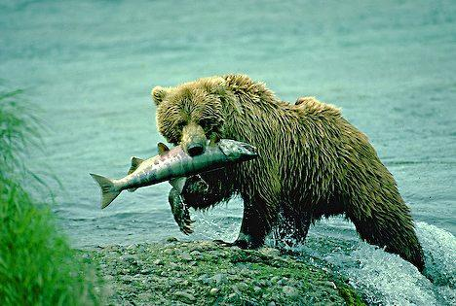
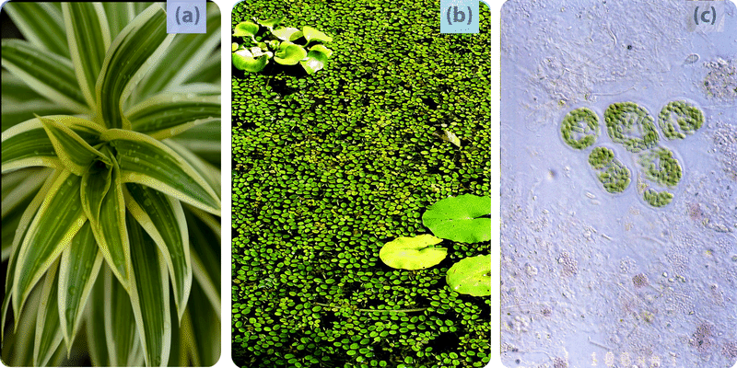
Autotroph & Heterotroph
Autotroph: an organism that makes its own food
Heterotroph: an organism that gets food by eating other organisms

Slide 7
AUTOTROPH: | HETEROTROPH:
1. Archaebacteria 2. Eubacteria 3. Prostist 4. Plant | 1. Eubacteria 2. Protist 3. Fungi 4. Animal

Slide 8
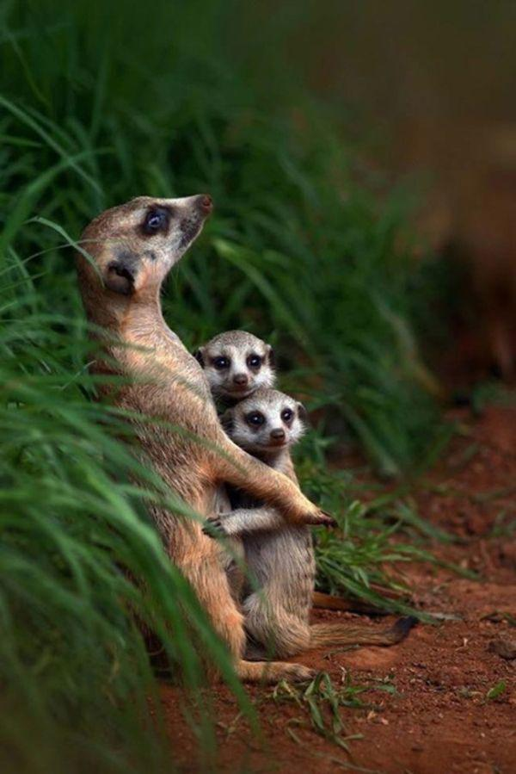
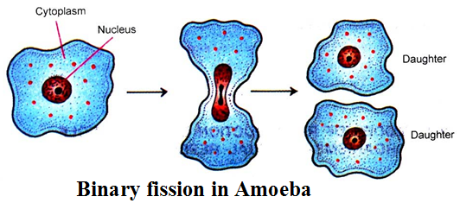
Asexual & Sexual Reproduction
Asexual Reproduction: type of reproduction by which offspring arise from a single parent
Sexual Reproduction: reproduction in which the sex cells from two parents unite to produce offspring that shares traits form both parents

Slide 9
ASEXUAL: | SEXUAL:
1. Archaebacteria 2. Eubacteria 3. Protist 4. Fungi 5. Plant 6. Animal | 1. Plant 2. Animal

Slide 10
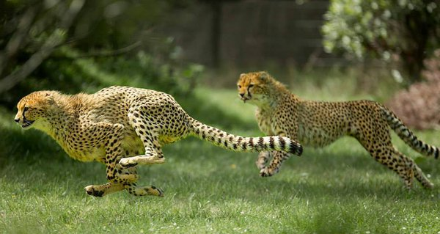
Mobile & Immobile
Immobile: does not have the ability to move on its own. These organisms can only move with help from external factors.
Mobile: has the ability to move on its own without help from an external factor

Slide 11
MOBILE: | IMMOBILE:
1. Archaebacteria 2. Eubacteria 3. Protist 4. Animal | 1. Plant 2. Fungi

