Slide 1
The Characteristics of Living Things

Slide 2
Characteristics of Living Things
What makes something living DIFFERENT from something non-living?
This clip from Sesame Street might help answer that question…

Slide 3
Characteristics of Living Things
There are actually 6 characteristics that will tell you if something is alive.
We call them “Characteristics of Living Things”
Let’s examine each of them…

Slide 4
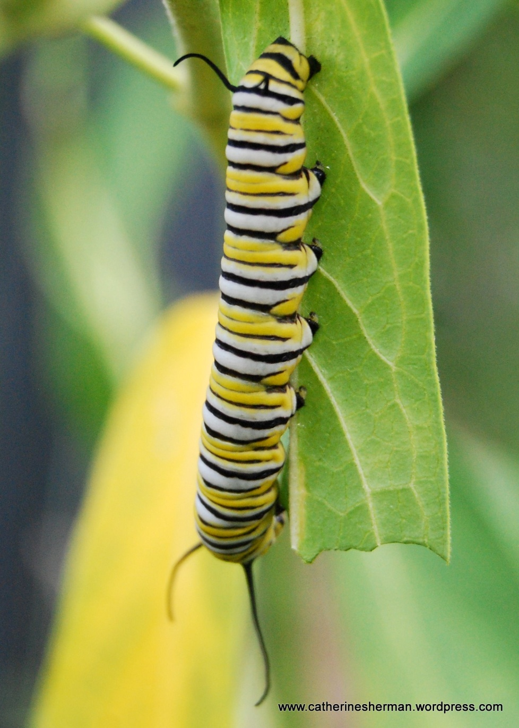
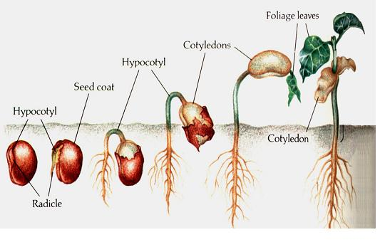
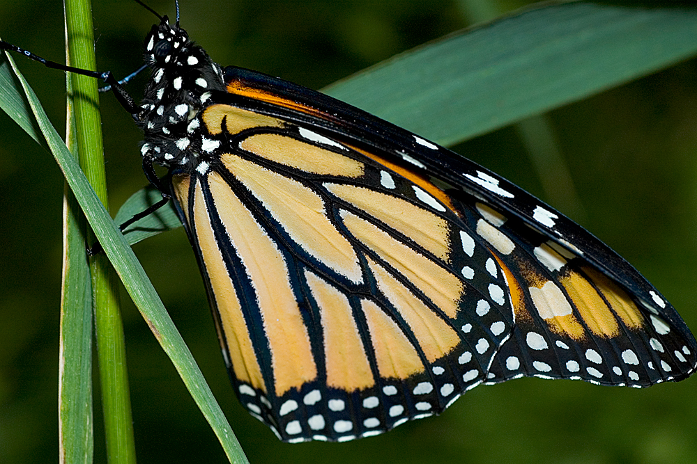
Characteristics of Living Things
1. Living things grow and develop.
Every organism develops at a different rate.
During development, a single cell divides again and again.
After these cells divide they begin to look different from one another and perform different functions.
As a seed grows, different parts of the plant develops.
Butterflies develop from caterpillars during their life cycle.

Slide 5
An icicle can grow, but why isn’t it alive?
Notes:
Answer: icicles grow, but cannot reproduce or eat

Slide 6
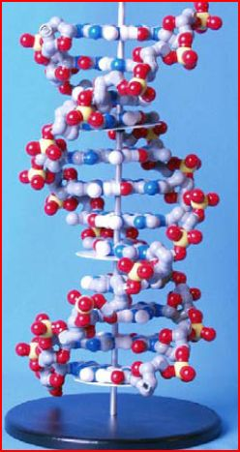
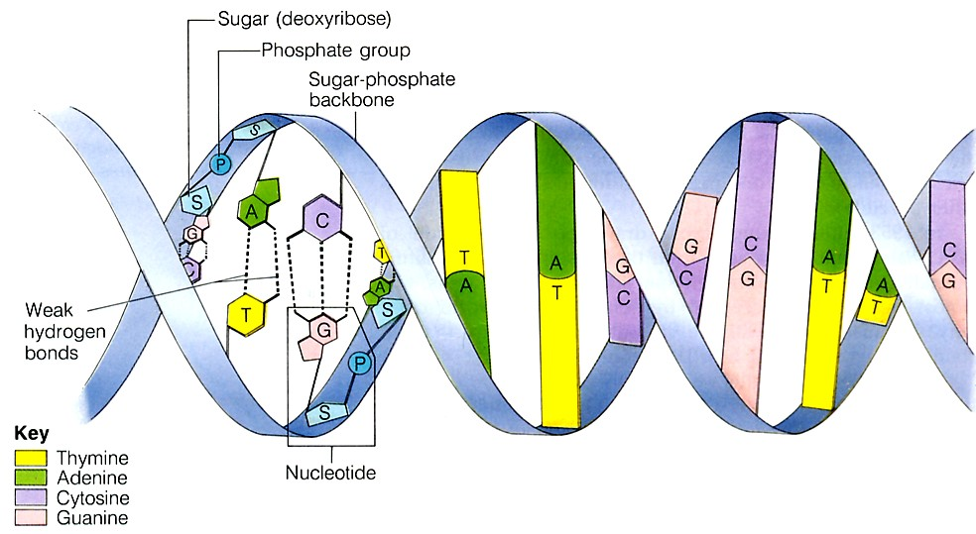
Characteristics of Living Things
2. Living things are based on a universal genetic code.
All organisms store information they need to live, grow, and reproduce in a genetic code written in a molecule called DNA.

Slide 7
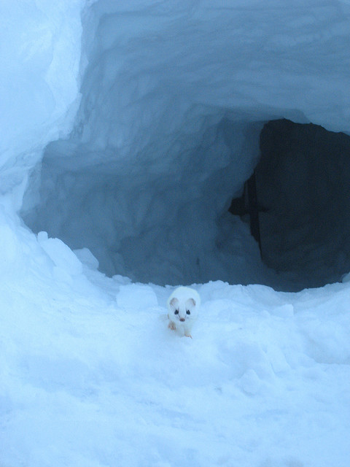
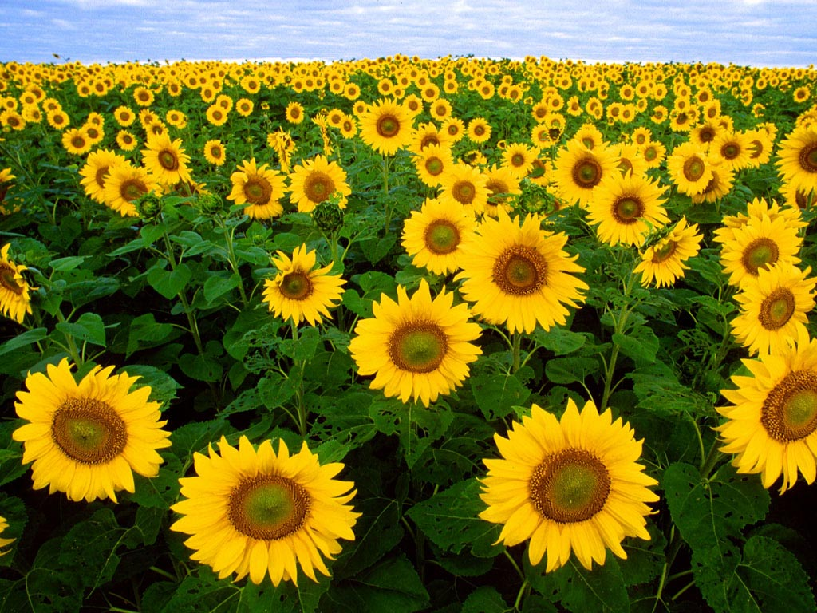
Characteristics of Living Things
3. Living things sense and respond to their environment.
Organisms detect and respond to signals from their environment
For example, plants respond to light by growing
Mammals respond to cold temperature by growing thicker fur.

Slide 8
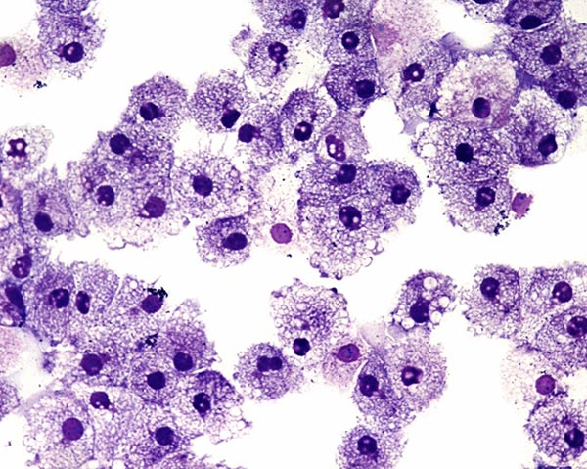
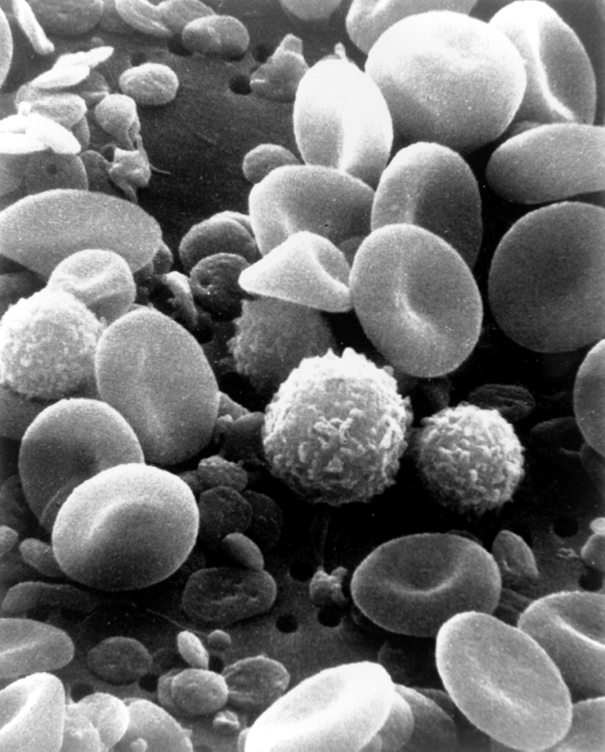
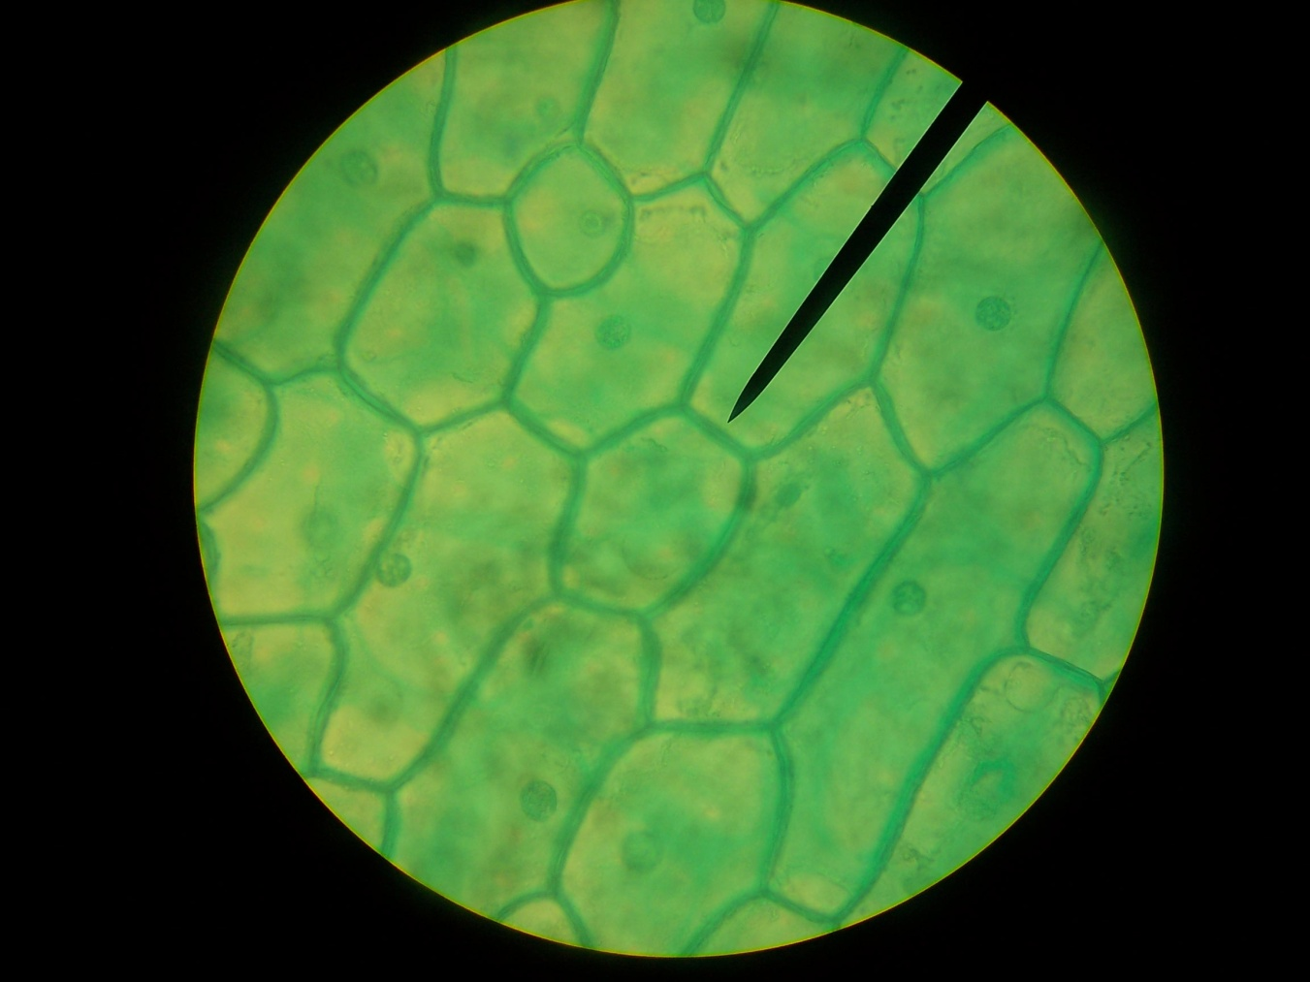
Characteristics of Living Things
4. Living things are made up of cells.
Organisms are composed of one or more cells.
Cells are the smallest living things.
Cells are complex and very organized.
Blood cells
Human cheek cells
Plant leaf cells

Slide 9
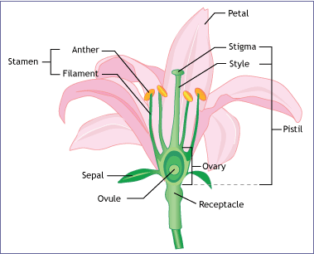
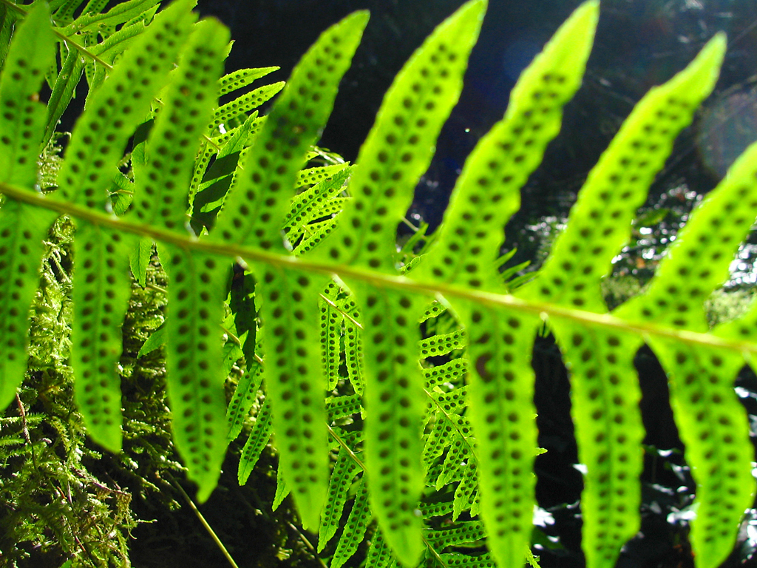
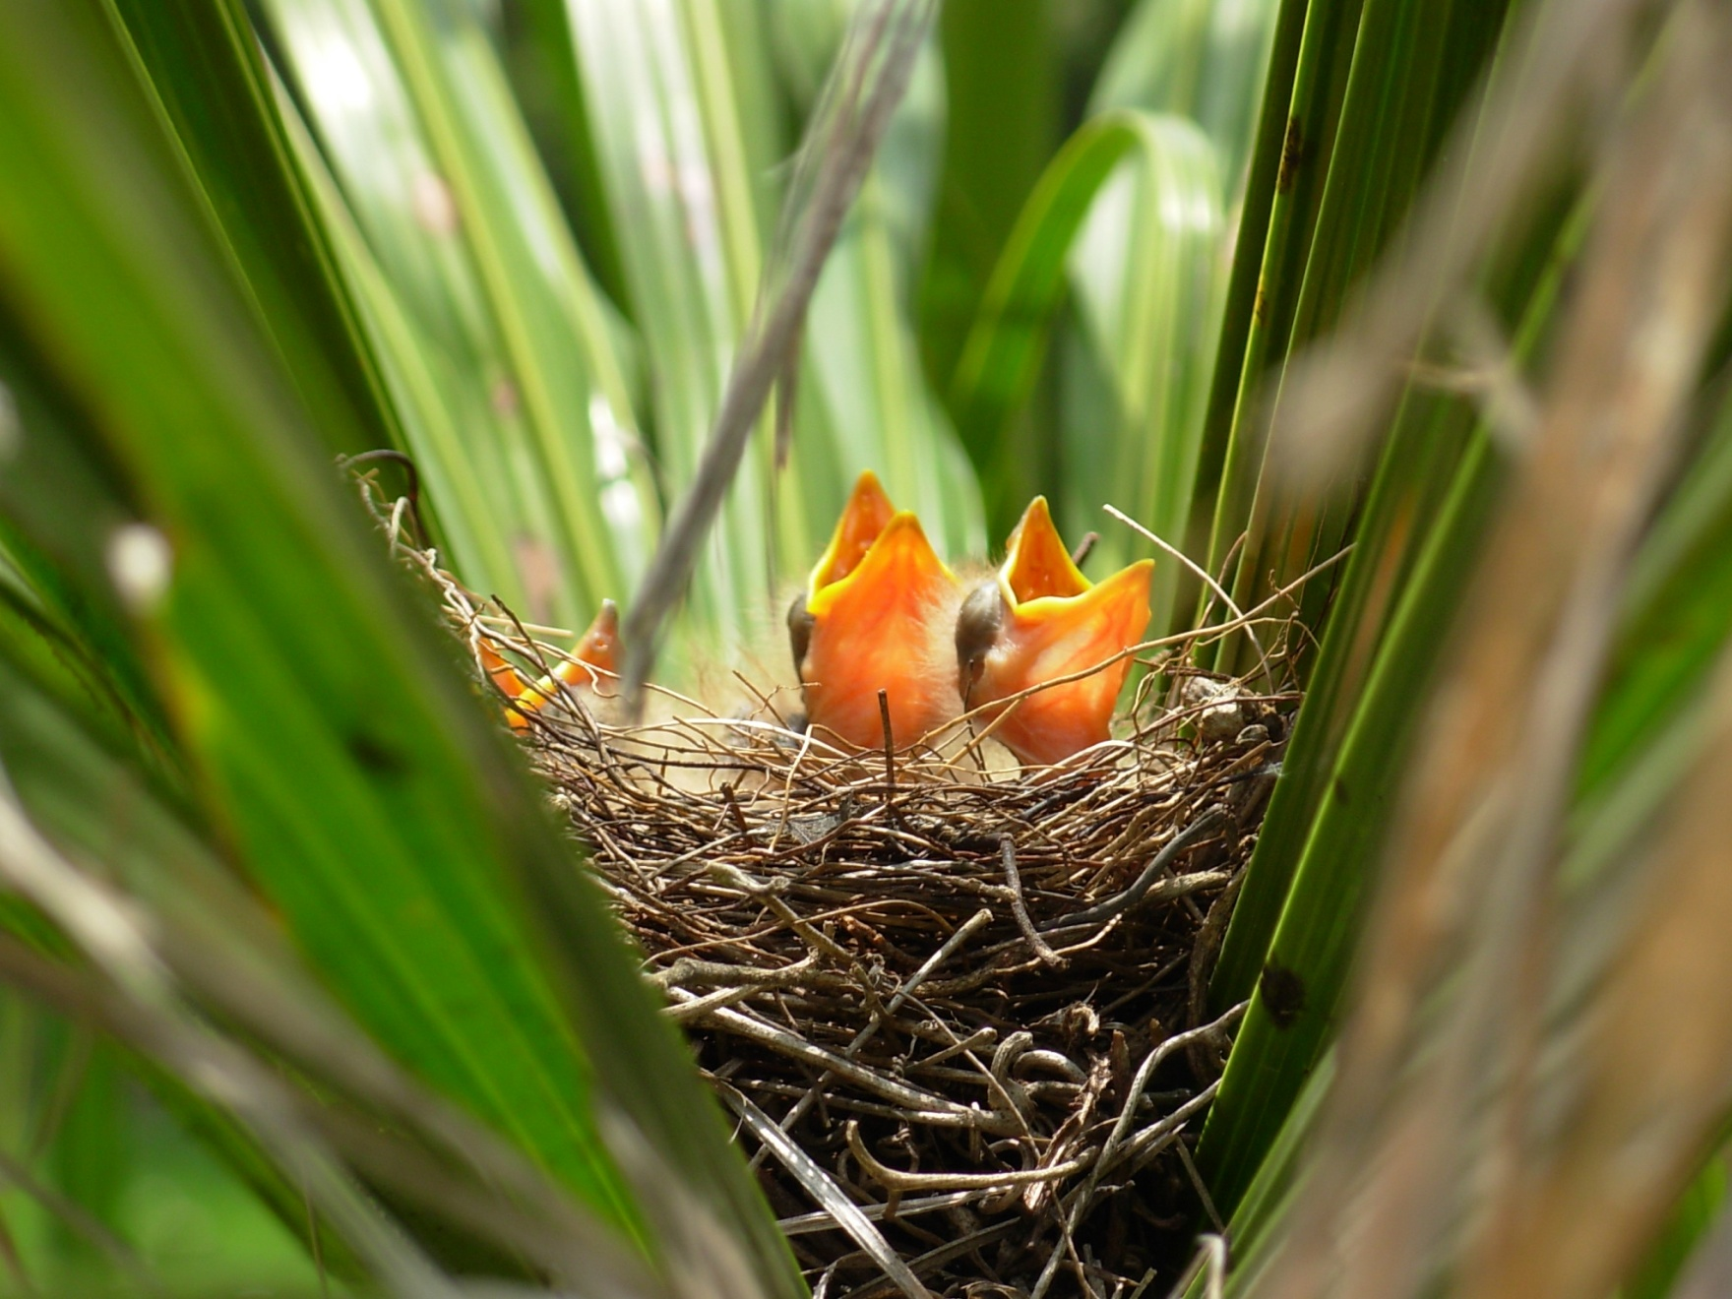
Characteristics of Living Things
5. Living things reproduce.
All organisms reproduce, which means that they produce new similar organisms.
Some organisms have two parents (sexual reproduction) and others have just one (asexual reproduction)
Birds have two parents, so these chicks were produced through sexual reproduction
This fern has produced spores by dividing its own leaf cells. A fern uses asexual reproduction
This flower has male and female sex cells, so it is using sexual reproduction

Slide 10
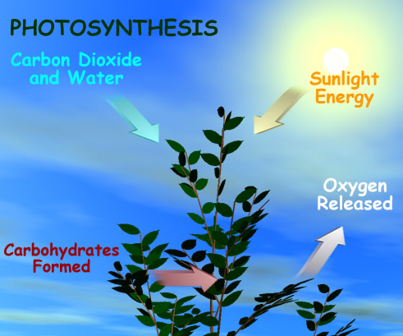
Characteristics of Living Things
6. Living things obtain and use material and energy.
All organisms must take in materials and energy to grow, develop, and reproduce.
Chemical reactions breaks down materials in what is called METABOLISM.

Slide 11
You can take any living organism and apply all six characteristics…

